Slide 1
Carnot Engine

Slide 2
A
D
B
C

Slide 3
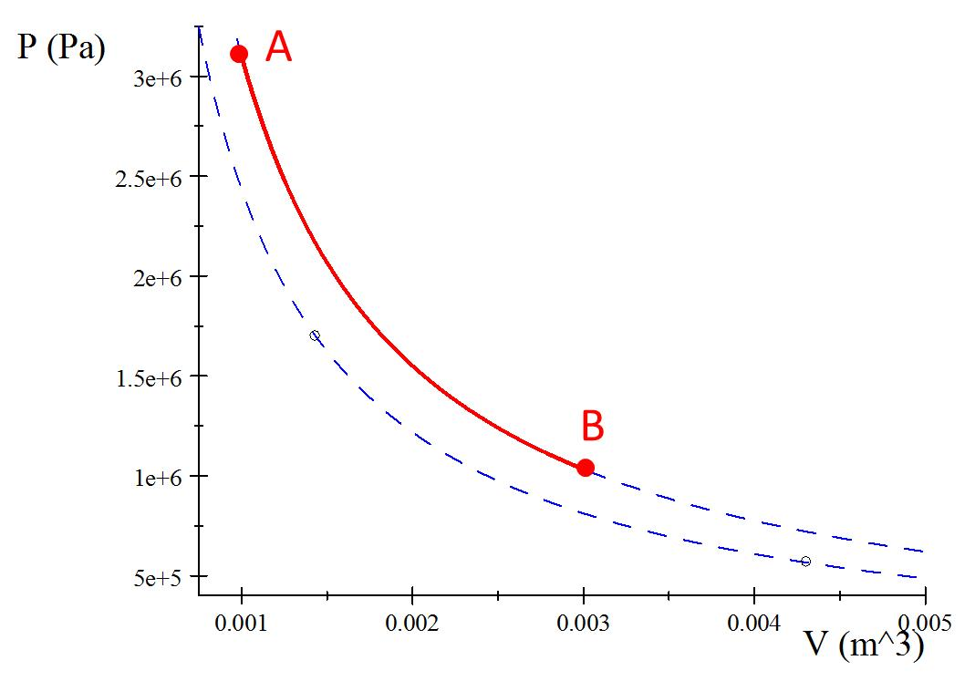

Process A to B
Q_{h}

Slide 4
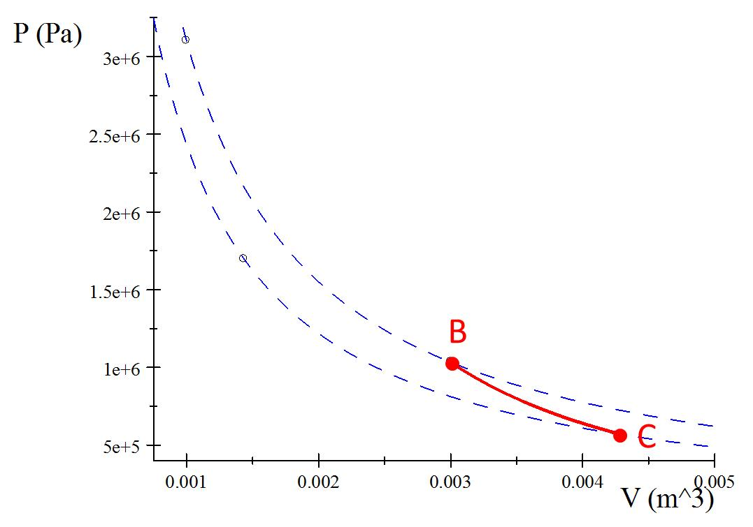
Process B to C
Insulator

Slide 5
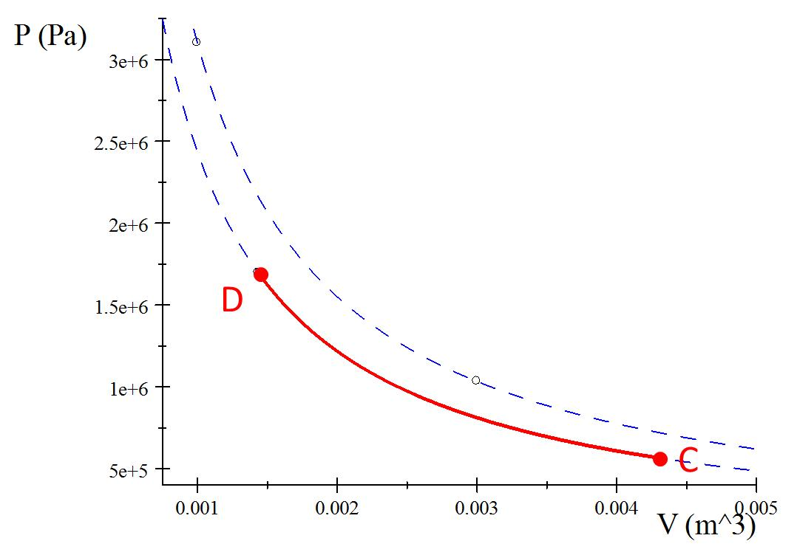
Process C to D
Q_{c}

Slide 6
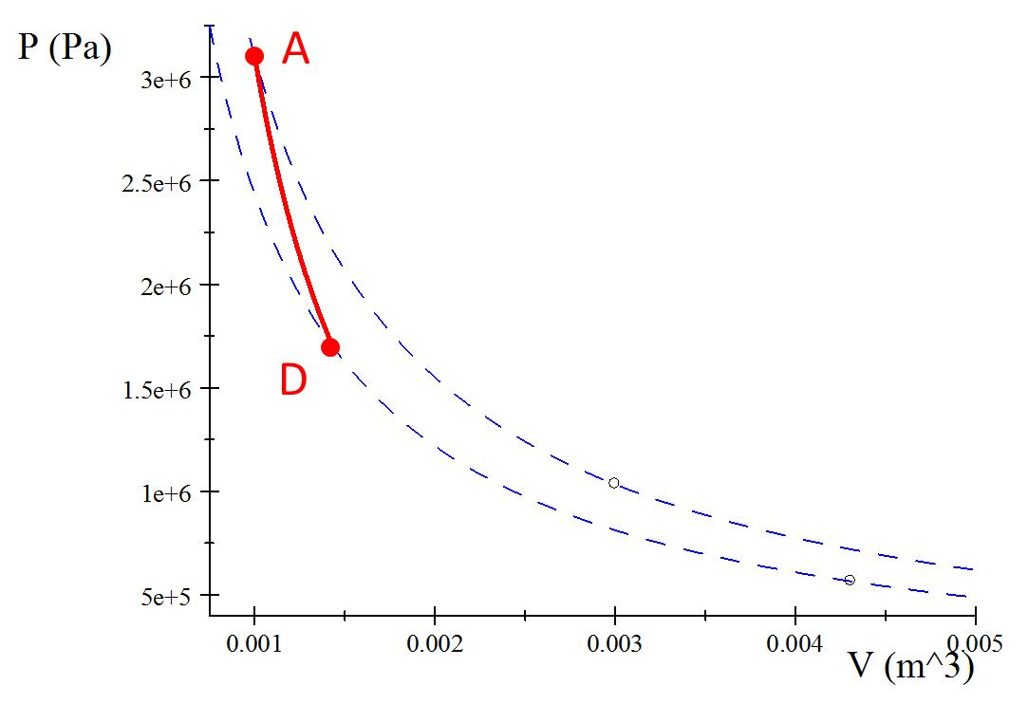
Process D to A
Insulator

Slide 7
A
B
C
D

Slide 8
Process A’B
A
B
Q_{h}

Slide 9
Process B’C
B
C
Insulator

Slide 10
Process C’D
D
C
Q_{c}

Slide 11
Process D’A
A
D
Insulator

Slide 12
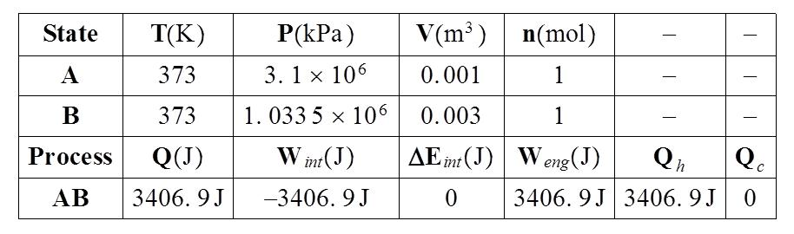

Slide 13





Identify the type of process
Write out the special equations for that process
Symbolically solve for ΔE, Q, W, P, V, and T
Identify your contribution to Q_{h} and Q_{c}
Fill in with numbers
$$V_{A}=0.001m^{3}$$
$$V_{C}=0.015m^{3}$$
$T_{A}=1023$K
$$T_{C}=293\text{K}$$
$n=$1mol

Slide 14
A
B
C
D

Slide 15
A
B
Q_{h}
Q_{c}
C
D

Slide 17


Identify the type of process
Write out the special equations for that process
Symbolically solve for ΔE, Q, W, P, V, and T
Identify your contribution to Q_{h} and Q_{c}
Fill in with numbers
$$V_{A}=0.001m^{3}$$
$$V_{C}=0.00431m^{3}$$
$T_{A}=373$K
$$T_{C}=293\text{K}$$
$n=$1mol

Slide 18
A
D
B
C

Slide 19
A
Q_{h}
D
B
Q_{c}
C

Slide 20
A
B

Slide 21
B
C

Slide 22
D
C

Slide 23
A
D

